Slide 1
Welcome to Marshall middle school
Homeroom

Slide 2
Homeroom agenda
Introduction
Student arrival
Absences
Activity Period
Afternoon dismissal

Slide 3
Student Arrival
8:00 – 8:10 Go to lockers
Students assigned lockers
8:10 = Tardy Bell
3 “unacceptable tardies” = detention
Channel 1 www.channelone.com
8:10 – 8:26 Homeroom/Morning Announcements
Give teacher notes (absences, early dismissals, walkers, parent pick-up)
Opportunity to see teachers for work/questions
Clubs or activities may meet

Slide 4
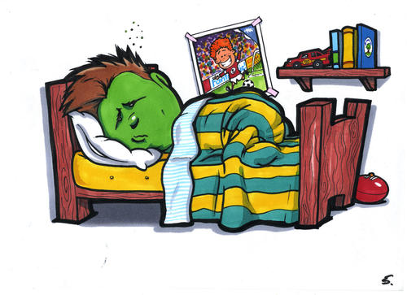
absences
3 days to turn in note after absence
After 3 days without a note = “illegal absence”
Excused vs. unexcused
Vacation forms
Known absences
5 days prior

Slide 5
Activity period
Approximately 2 – 3/week
Students sign-out to go various places
Opportunity for clubs/music to meet
Quiet study hall

Slide 6
Afternoon dismissaL
10th period/Activity period ends 2:52
Return to lockers and pack up
Dismissal – 2:58

Slide 7
Other Information
Any notes – sick/early dismissal (include student ID)
3 Conduct Cards = 1 detention
Box Tops / Magazine Sale
Intramurals
Attendance – recorded phone call
Returning a student – parent does not need to come in the office
Student pick-up – parents needs to come into the office

Slide 8
A few things to view…
Building Team Unity
Team Days
Autobiographical Poem/Bioglyph/Dossier
Outside of homeroom
Science Flipbooks
Lockers
Post-it with locker number
ENJOY YOUR EVENING!

